Slide 1
How individuals learn to take turns: Emergence of alternating cooperation in a congestion game and the prisoner‘s dilemma
Dirk Helbing, Martin Schönhof and Hans-Ulrich Stark

Slide 2
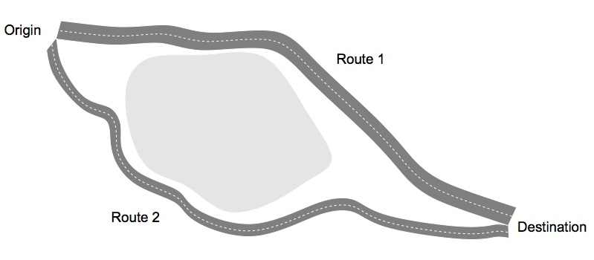
Route choice game
Illustration of the route choice game

Slide 3
Route choice game
1
2
0 | 300
-100 | -200
User equilibrium
Route 1
System optimum
Route 2
P₁₂ + P₂₁ > 2P₁₁
Payoff specification for player 1

Slide 4
Experiments
N₁=1 : System optimum
N₁=2 : User equilibrium
17/24 persistent cooperation
Example of emergence of coherent oscillations

Slide 5
Experiments
N₁=1 : System optimum
N₁=2 : User equilibrium
Person 1 is uncooperative
Changing frequency too low
No cooperation

Slide 6
Experiments
Participant 1 is selfish
No punishment
Punishment

Slide 7
Model
Agents switch strategy with ν_{l}(t) → Necessary exploratory behavior

Slide 8
Model
Application

Slide 9
Prisoner‘s Dilemma
0 | -300
100 | -200
0 | -300
500 | -200
Model simulation

Slide 10
Real world application
Automated route guidance system
Recommended route according to the system optimum
  Faster route → Fee according to congestion
How to make people cooperate

Slide 11
Questions?

