Slide 1
The outbreak of cooperation among success-driven individuals under noisy conditions
Success-driven migration and imitation as a driver for cooperative behavior
Notes:
Article written by Dirk Helbing and Wenjian Yu

Slide 2
Context and content
Evolutionary game theory as a model to explain cooperation in interactions, based on prisoner’s dilemma
Main addition to existing literature is success-driven migration
Agent-based model with set of parameters
Simulations with varying conditions
Discussion & Conclusion
Notes:
Intro..

Slide 3
The model
Prisoner’s dilemma T>R>P>S, two types of behavior
People in grid, interact with <=4 neighbors for an outcome
Comparison with neighbors for best strategy, then:
  Check for ‘better’ areas around you, and move
  Imitate neighbors with better outcomes
Possibility of ‘noise’ (randomness) in strategy and relocation
Implications: cooperation is fragile!

Slide 4
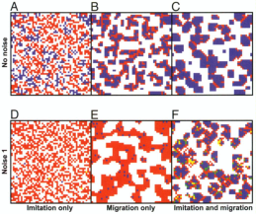
Base model
Notes:
Only imitation: mix of cooperators/defectors
Only migration: islands of cooperators, defectors at edge → explanation in next slide
Both: success for cooperators!
With noise 1 (randomness in strategy):
Only imitation: only defectors
Only migration: islands of (mostly) defectors
Both: success for cooperators! (more or less)
So: cooperation in clusters, with defectors at edges. How is that possible?

Slide 5
Example of defectors in clusters or at edges
T>R>P>S
1.3>1.0>0.3>0
Notes:
Example of what happens in different setups of cooperators and defectors:
In upper scenario: a defector’s paradise: its payoffs are so high it turns cooperators around it, until everyone defects
In lower scenario: just because of too few neighbors, the defecting behavior doesn’t invade the cooperative cluster.
Note: because of randomness of chosen individual to act, different outcomes may occur!

Slide 6
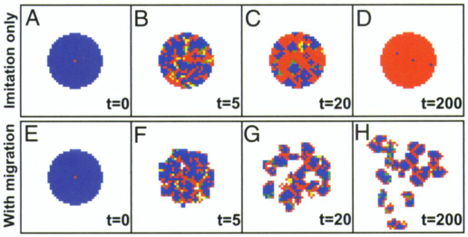
Defector’s Paradise
Notes:
Defectors among cooperators are successful and ‘corrupt’ cooperators
Clusters of cooperators are successful and stable
Defectors at edges are successful but don’t have enough success to ‘corrupt’ cooperators because they have less neighbors and less overall outcome
Here: without migration the corruption of cooperators is inevitable
But: with migration the cooperators can escape the defectors and move away from the circle

Slide 7
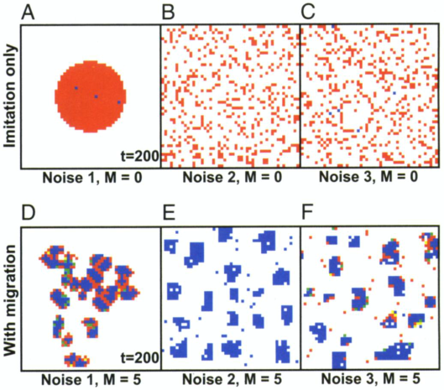
Varying Types of Noises
Notes:
A – C: Invasion scenario with defector in center of a cooperative cluster, without migration
The Noise 2 (random relocations) destroys the spatial patterns (no clusters formed) , so does Noise 3 (combination of 1 (strategy mutations) and 2). Defectors dominate largely
D – F: Small cooperative clusters are shaped in each scenario – The combination imitation and success-driven migration is therefore a robust mechanism.

Slide 8
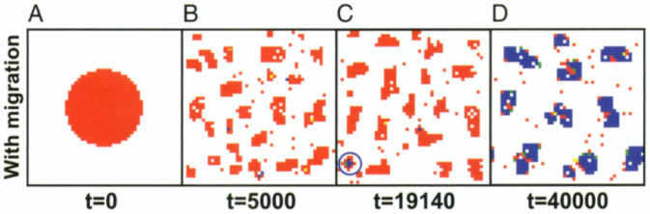
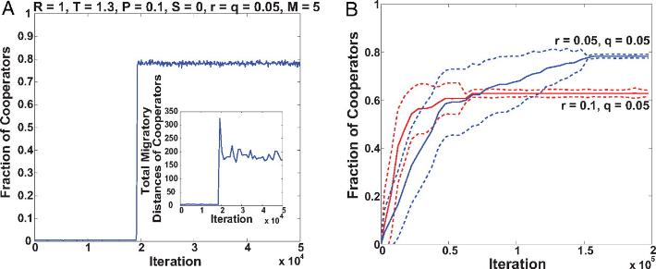
Outbreak of Cooperative Behaviour
Notes:
Spontaneous outbreak of cooperative cluster, after a big number of iterations
After outbreak the cooperative fraction comes to prevail
Although strategy mutations are in favor of defection

Slide 9
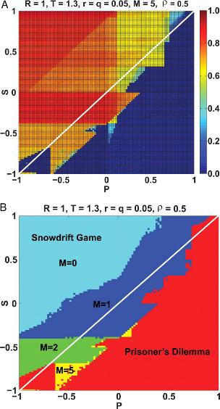
Varying Payoff Parameters
Diagonal line set by:
$$n_{1}R+n_{2}S=n_{3}T+n_{4}P$$
Notes:
Understanding the conditions for the spreading of cooperators from a supercritical cluster.
The equation sets the diagonal line, What the variables stand for: Reward Sucker’s payoff Temptation Punishment. Above the line – cooperators spread. Below the line – defector invade.
The lower diagram displays different range of migration (M)
Snowdrift game: S > P

Slide 10
Discussion/Conclusion
Success-driven migration
Explaining cooperation in an egoistic world
Mobility’ significance in social order
Role of local agglomeration

Slide 11
Questions?
Thank you for listening, hope it was interesting

