Slide 1
Evolutionary dynamics of populations with conflicting interactions
Classification and analytical treatment considering asymmetry and power

Slide 2
Game-Dynamical replicator equations for interacting populations
In the following, we will formulate game-dynamical equations for multi-population interactions.
We will distinguish different sub-populations:
and various states (behaviors, strategies):

Slide 3
If characterized by state interacts with characterized by state , the outcome, “success”, is the payoff:
Let be the fraction of entities belonging to population a.
Let be the proportion of entities in a characterized by state i at time t.

Slide 4
When the interaction frequency with entities of population characterized by state is
We find the set of coupled game-dynamical equations
Where:
is the expected success of entities in a with state i and
is the average success in a

Slide 5
For simplicity, we will now focus on the case of two populations ( ) with two states each ( ). This allows to reduce the number of variables by means of the normalization conditions:
And we find:

Slide 6
When evaluating we will write the payoffs for as
To reflect conflicting interactions the payoffs for are assumed to be inverted:

Slide 7
Adopting the notation , and
We introduce also the following notation:
Where
Inserting these in the previous equations provides the general equations for all possible 2x2 games and even situations where the two populations play different kinds of games.

Slide 9
Special Cases
No interactions between entities of different population is
Both populations separately behave as in one-population case

Slide 10
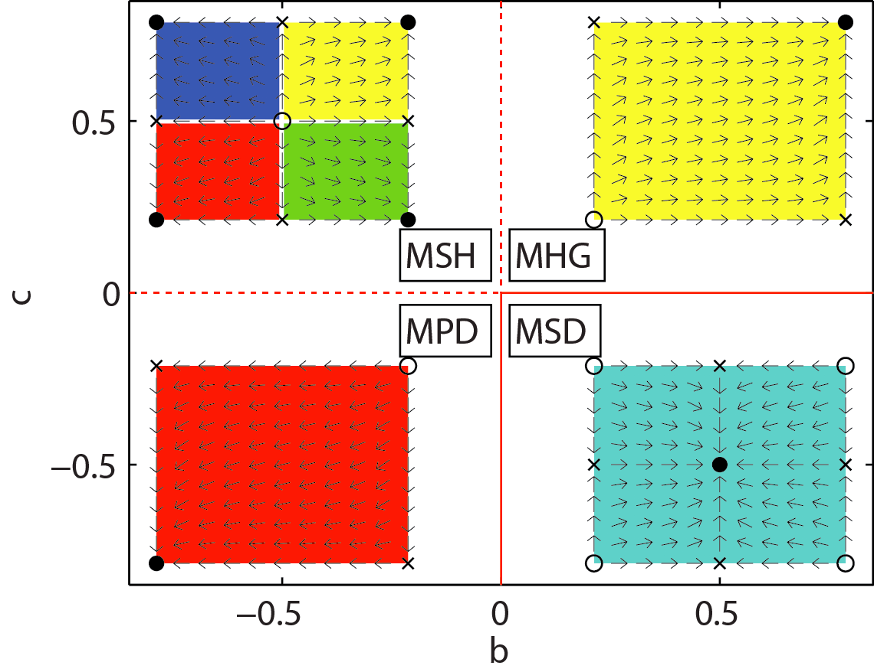

Slide 11
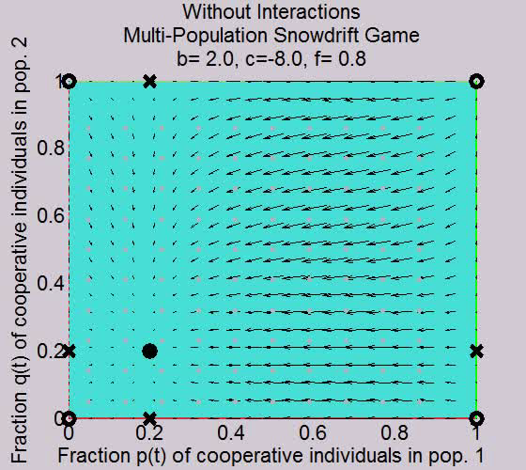

Slide 12
Special Cases
No self -interactions between entities of the same population is
Conventional bimatrix games

Slide 13
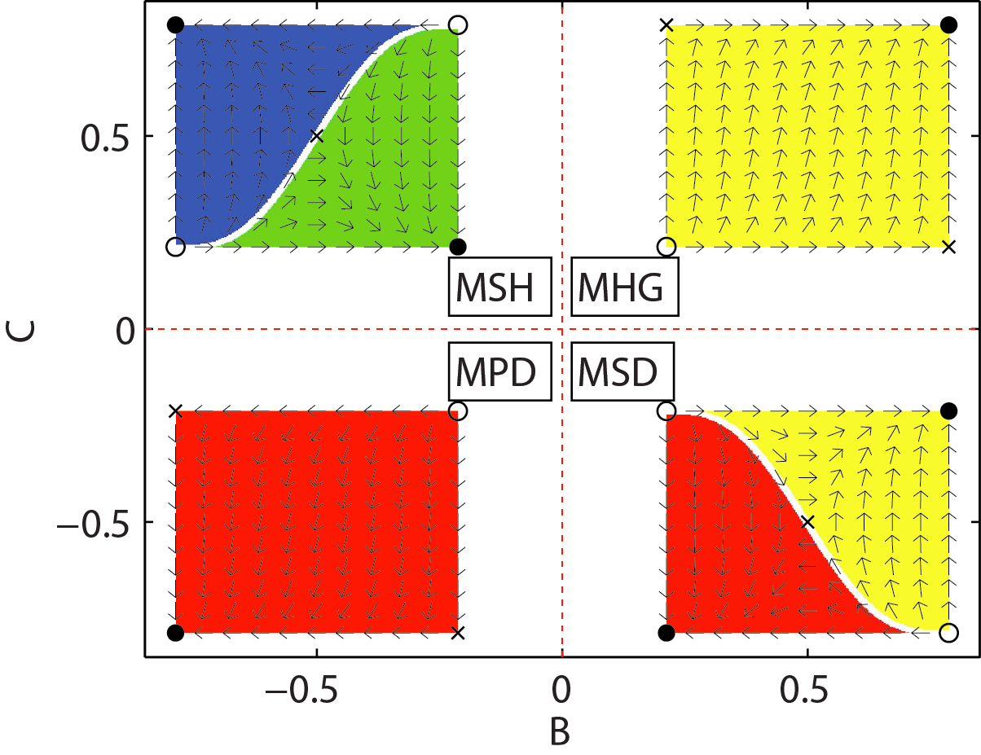

Slide 14
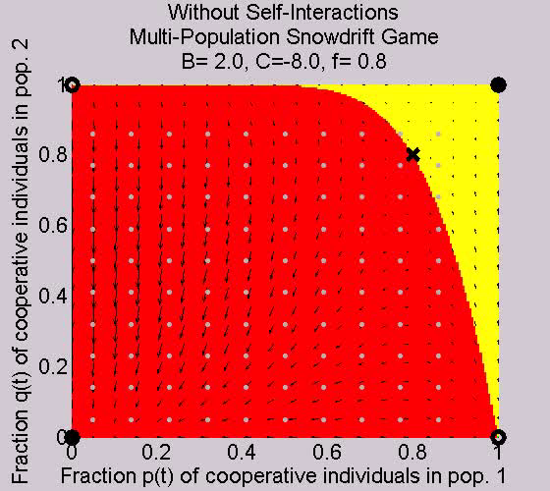

Slide 15
Special Cases
Now we will assume that everyone has interactions with entity of all populations with a frequency that is proportional to the relative population size
For simplicity we will assume also
So that the payoffs depend only on the state but not on the population of the interaction partner

Slide 16
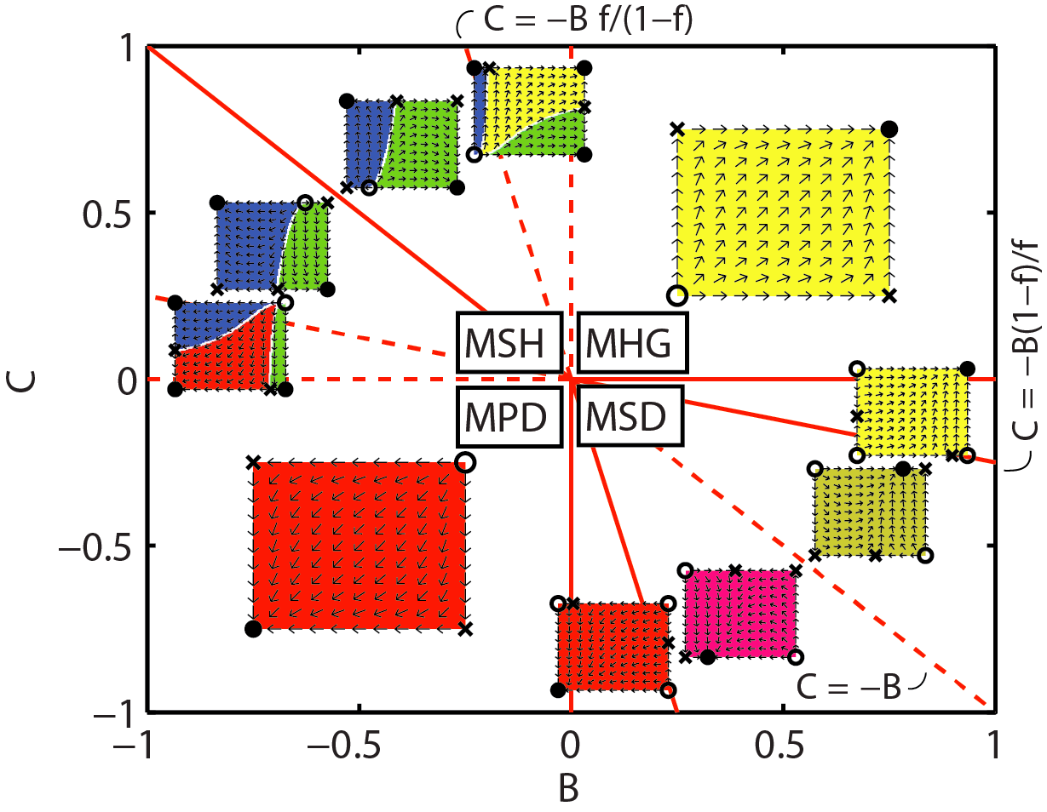

Slide 17
Stationary solutions, eigenvalues and possible system dynamics
In the two-dimensional space define by p and q we can derive the qualitative vector fields from the stationary solution (Dynamical System Analysis)
The stationary solution and their stability properties can be calculated analytically from the their eigenvalues
There are exact mathematical formulas for them

Slide 18
Stationary solutions are identified setting
From the set of linearized equations
we get the respective eigenvalues with which we can
solve the system of differential equations

Slide 19
The eigenvalues are the two solutions of
From this analysis we get the following stationary solutions:

Slide 20
If we have an equilibrium selection problem:
and are always stable fix points
is stable for
is stable for
Other 4 stationary points may occur:
  fix point for
  fix point for
  fix point for
  fix point for

Slide 21
Phase transitions
It is natural that a change in the parameters B,C and f causes changes in the system dynamics analysis
When critical thresholds are crossed new stable fix points may show up and disappears in remote places (first order discontinuous phase transition)
The locations of certain stable fix points may change continuously while the dislocation speed changes discontinuously crossing threshold parameters (second order phase transition)

Slide 22
Classification of different type of system dynamics
The stability of stationary points and the system dynamics change when B or C cross the zero line
We can distinguish 4 archetypical games
The entities are assumed to be individuals
The states represents behaviors
R > P without loss of generality

Slide 23
Terminology
Two individuals show the same behavior, we will talk about coordinated behavior
Preferred behavior is the behavior which gives the higher payoff when the interaction partner shows the same behavior (R) while the non-preferred is P
If one chooses its preferred behavior and the interaction partner chooses a different behavior, the first one receives the payoff S and the second one the payoff T

Slide 24
Cooperative behavior is a matter of perspective
Population 1 prefers behavior 1, population 2 behavior 2
Behavior 1 is cooperative for population 1, but is the non-preferred behavior of the interaction partner
if two interacting individuals display the same behavior, their behavior is coordinated.
A behavioral norm is when all show the same coordinated behavior independently of their behavioral preferences and the sub-population they belong to

Slide 25
Four types of games:
  Multi-population Prisoner’s dilemma for or B<0 and C<0
    Breakdown of cooperation
    Both populations end up with non-preferred behaviors
  Multi-population Harmony game for or B>0 and C>0
    All individuals end up with their preferred behaviors
    The behaviors are not coordinated
  Multi-population Stag-Hunt game for or B<0, C>0
    Dynamics depends on initial conditions
    In some cases a social norm is established
    In others a commonly shared behavior may not be established
  Multi-population Snow-Drift game for or B>0, C<0
    It can happen that individuals in the stronger pop do not coordinate with each other (social conflicts)
    Discontinuous transition at |B|=|C| leads to revolution: weaker population turns from cooperative behavior to uncooperative
    The stronger population controls the behavior of the weaker

Slide 27
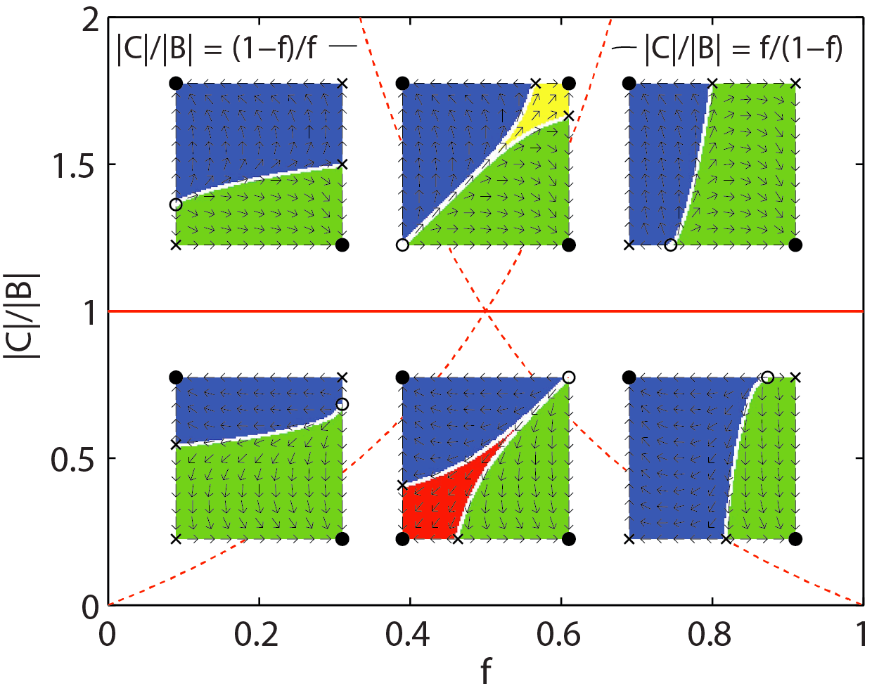

Slide 28
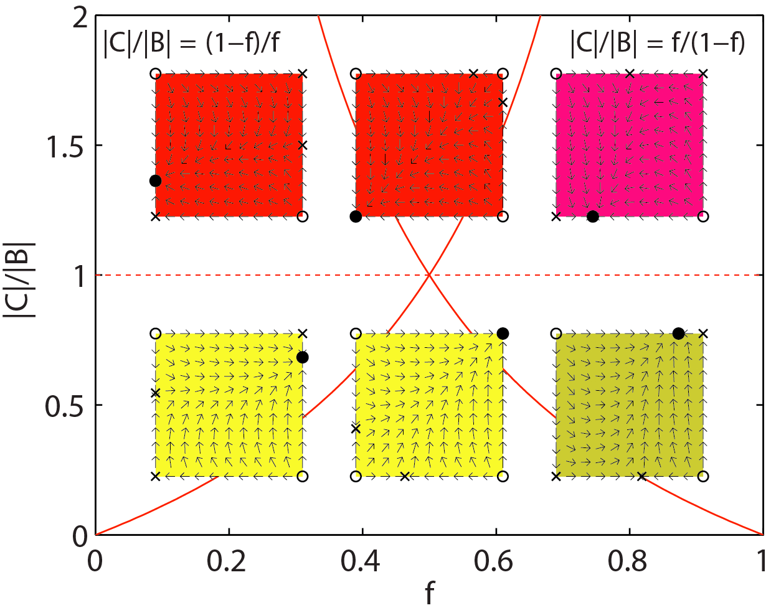

Slide 29
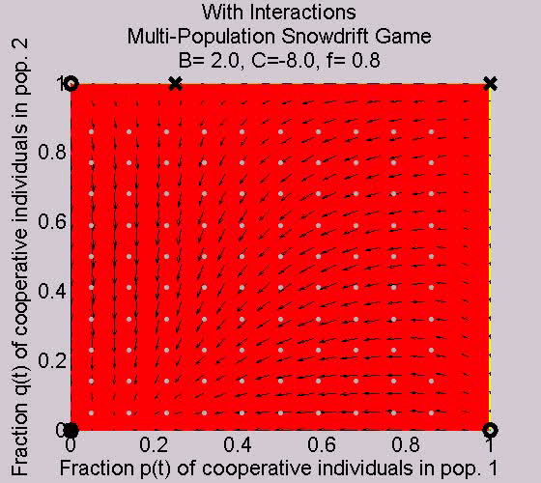

Slide 30
Summary
Multi-population replicator equation describe populations with conflicting interactions and different power
4 types of games:
  Harmony game, Prisoner’s Dilemma, Stag-Hunt game, Snowdrift game
Establishment of cooperation and social norms are two of the challenges of social systems
It would be interesting to test whether this theory has predictive power in reality

