Slide 1
A section-based queueing-theoretical traffic model for congestion and travel time analysis in networks

Slide 2
Agenda
Title translation and model introduction
Motivating question
Assumptions
Key steps
Results
Questions

Slide 3
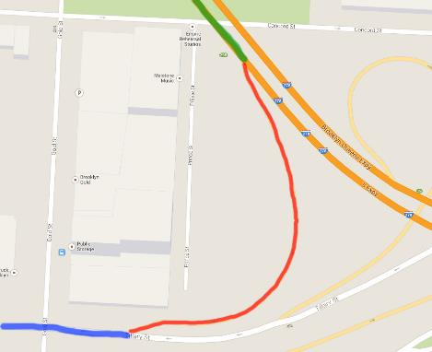
Title translation and model introduction
Separated by capacity:
A section-based …

Slide 4
Title translation and model introduction
Separated by capacity:
Highway with multiple lines
A section-based …

Slide 5
Title translation and model introduction
Separated by capacity:
Highway with multiple lines
Off-ramp, single line
A section-based …

Slide 6
Title translation and model introduction
Separated by capacity:
Highway with multiple lines
Off-ramp, single line
Main street, multiple lines
A section-based …

Slide 7
Title translation and model introduction
Points of interest:
A section-based …

Slide 8
Title translation and model introduction
Points of interest:
Measure the flow
A section-based …

Slide 9
Title translation and model introduction
Points of interest:
Measure the flow
Reasons for capacity change:
A section-based …

Slide 10
Title translation and model introduction
Points of interest:
Measure the flow
Reasons for capacity change:
On- or off-ramp
A section-based …

Slide 11
Title translation and model introduction
Points of interest:
Measure the flow
Reasons for capacity change:
On- or off-ramp
Change in number of lines
A section-based …

Slide 12
Title translation and model introduction
Points of interest:
Measure the flow
Reasons for capacity change:
On- or off-ramp
Change in number of lines
Change of gradient
A section-based …

Slide 13
Title translation and model introduction
queueing-theoretical …

Slide 14
Title translation and model introduction
traffic model for congestion …

Slide 15
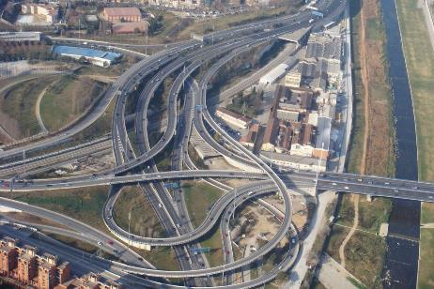
Title translation and model introduction
and travel time analysis in networks

Slide 16
Title translation and model introduction

Slide 17
Title translation and model introduction

Slide 18
Agenda
Title translation and model introduction ✓
Motivating question
Assumptions
Key steps
Results
Questions

Slide 19
Motivating question
What is the expected travel time for a traffic member to go from A to B?

Slide 20
Motivating question
What is the expected travel time for a traffic member to go from A to B, passing a certain network, including dynamic vehicle density?

Slide 21
Agenda
Title translation and model introduction ✓
Motivating question ✓
Assumptions
Key steps
Results
Questions

Slide 22
Assumption 1
Below some critical vehicle density , the relation between the traffic flow and density is linear

Slide 23
Assumption 2

Slide 24
Assumption 2
Propagation speed of density variation in
free traffic: the average speed of the cars (30 km/h)

Slide 25
Assumption 2
Propagation speed of density variation in
free traffic: the average speed of the cars (30 km/h)
congested traffic: Shockwave formulas => … => 20 km/h

Slide 26
Assumption 3
The length of the congested area is given by integrating over

Slide 27
Assumption 3
The length of the congested area is given by integrating over

Slide 28
Assumption 3
The length of the congested area is given by integrating over
In english:

Slide 29
Assumption 4
The capacity of a congested road = outflow - bottleneck

Slide 30
Assumption 4
The capacity of a congested road = outflow - bottleneck
Less cars can leave the section, but the arrival rate stays the same

Slide 31
Assumption 4
The capacity of a congested road = outflow - bottleneck
Less cars can leave the section, but the arrival rate stays the same
Congestion grows

Slide 32
Assumption 4
The capacity of a congested road = outflow - bottleneck
Less cars can leave the section, but the arrival rate stays the same
Congestion grows
More cars can leave the section, arrival rate stays the same

Slide 33
Assumption 4
The capacity of a congested road = outflow - bottleneck
Less cars can leave the section, but the arrival rate stays the same
Congestion grows
More cars can leave the section, arrival rate stays the same
Congestion gets reduced

Slide 34
Agenda
Title translation and model introduction ✓
Motivating question ✓
Assumptions ✓
Key steps
Results
Questions

Slide 35
Key steps
We saw:

Slide 36
Key steps
We saw:
Choice of parameters

Slide 37
Key steps
We saw:
Choice of parameters
Definition of the model

Slide 38
Key steps
We saw:
Choice of parameters
Definition of the model
Choice of assumptions

Slide 39
Key steps
Next step:
Introduction of road states:

Slide 40
Key steps
Next step:
Introduction of road states:
0: Free traffic

Slide 41
Key steps
Next step:
Introduction of road states:
0: Free traffic
1: Completely congested road

Slide 42
Key steps
Next step:
Introduction of road states:
0: Free traffic
1: Completely congested road
2: Partially congested road

Slide 43
Key steps
Final step: Definition of the departure rate

Slide 44
Key steps
Case: Free traffic here and no congestion in the next section
Cars drive through:

Slide 45
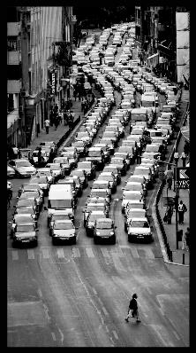
Key steps
Case: Partial or complete congestion here, no in next section
Fight through local jam: Assumption 4 =>

Slide 46
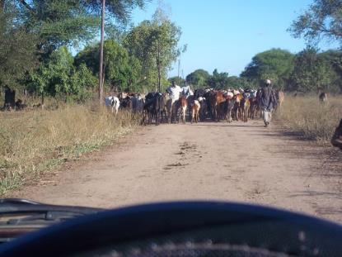
Key steps
Case: Next section is completely congested
Its totally dependent on how the traffic rolls in the next section:

Slide 47
Agenda
Title translation and model introduction ✓
Motivating question ✓
Assumptions ✓
Key steps ✓
Results
Questions

Slide 48
Results
We now can derive a general relationship for the average travel time trough a section:

Slide 49
Results
We now can derive a general relationship for the average travel time trough a section:
When we enter the section i at time t, we will leave this section when the vehicles that are in section i at time t have passed throught it. We can derivate the following formula:

Slide 50
Results
We now can derive a general relationship for the average travel time trough a section:
When we enter the section i at time t, we will leave this section when the vehicles that are in section i at time t have passed throught it. We can derivate the following formula:

Slide 51
Results
We now can derive a general relationship for the average travel time trough a section:
When we enter the section i at time t, we will leave this section when the vehicles that are in section i at time t have passed throught it. We can derivate the following formula:

Slide 52
Results
Making use of some maths reveals

Slide 53
Results
Making use of some maths reveals
So, what does this formula mean?

Slide 54
Results
Making use of some maths reveals
So, what does this formula mean?
The travel time increases with time, when the arrival rate at time exceeds the departure time at time (when I want to leave)

Slide 55
Results
Making use of some maths reveals
So, what does this formula mean?
The travel time increases with time, when the arrival rate at time exceeds the departure time at time (when I want to leave)
Else, the congestion shrinks, the travel time decreases

Slide 56
Results
Making use of some maths reveals
So, what does this formula mean?
The travel time increases with time, when the arrival rate at time exceeds the departure time at time (when I want to leave)
Else, the congestion shrinks, the travel time decreases
Fascinating detail: no velocities in the formula!

Slide 57
Results
Example:
Assume you enter the double-lined highway. The arrival rate at 9:30 am is 50 cars/minute. 15 minutes later you arrive at the off-ramp, but just in front of it happened an accident. The police closed one line. Due to this bottleneck the departure rate drops from 50 to 10.

Slide 58
Results
Example:
Assume you enter the double-lined highway. The arrival rate at 9:30 am is 50 cars/minute. 15 minutes later you arrive at the off-ramp, but just in front of it happened an accident. The police closed one line. Due to this bottleneck the departure rate drops from 50 to 10.
Apply the formula:

Slide 59
Results
Example:
Assume you enter the double-lined highway. The arrival rate at 9:30 am is 50 cars/minute. 15 minutes later you arrive at the off-ramp, but just in front of it happened an accident. The police closed one line. Due to this bottleneck the departure rate drops from 50 to 10.
Apply the formula:
Because 4 > 0, the average travel time grows

Slide 60
Results
So, we did:

Slide 61
Results
So, we did:
Some fancy modelling

Slide 62
Results
So, we did:
Some fancy modelling
Some fancy math

Slide 63
Results
We did:
Some fancy modelling…
Some fancy math…
Some fancy deductions…

Slide 64
Results
What fancy stuff can we do with this?

Slide 65
Results
What fancy stuff can we do with this?
Predict the average travel time for a single vehicle

Slide 66
Results
What fancy stuff can we do with this?
Predict the average travel time for a single vehicle
Predict time loss due to a building site
Is a detour needed?
Is it even feasible?

Slide 67
Results
What fancy stuff can we do with this?
Predict the average travel time for a single vehicle
Predict time loss due to a building site
Is a detour needed?
Is it even feasible?
Model real traffic situations/systems and simulate solutions/changes on computers

Slide 68
Results
What fancy stuff can we do with this?
Predict the average travel time for a single vehicle
Predict time loss due to a building site
Is a detour needed?
Is it even feasible?
Model real traffic situations/systems and simulate solutions/changes on computers
Ect…

Slide 69
Agenda
Title translation and model introduction ✓
Motivating question ✓
Assumptions ✓
Key steps ✓
Results ✓
Questions

Slide 70
Thanks for your attention!

Slide 71
Questions

