Slide 1
Active Walker Model for the Formation of Human and Animal Trail Systems
D. Helbing, F. Schweitzer, J. Keltsch, P. Molnár

Slide 2
Active Walker Explained
Acts according to the environment
Also locally changes the environment himself
In particular, changes produced by some walkers can influence other walkers (indirect interaction)
A set of simple rules describes his behaviour
Notes:
For computational science:
Active walker → class
Agent → object of that class

Slide 3
Simplified Equation of Motion
velocity
desired velocity
desired direction
ground potential
scaling coefficient
randomized direction
Notes:
Assumptions of model:
no direct interaction between different agents (social force concept neglected, attraction as well as repulsion)
Only way of communication: markings on ground -> changing the potential
\tau_\alpha is rather short compared to the durability T_k
Reaction time of agents is much smaller than the time it needs to change the potential significantly
\frac{d\vec{r}_\alpha}{dt} = \vec{v}_\alpha \left( \vec{r}_\alpha,t \right) \approx v_\alpha^0 \cdot \vec{e}_\alpha \left( G \left( \vec{r},t \right) , \vec{r}_\alpha, \vec{v}_\alpha \right) + \sqrt{2\varepsilon_\alpha \tau_\alpha}\cdot \vec{\xi}_\alpha \left( t \right)

Slide 4
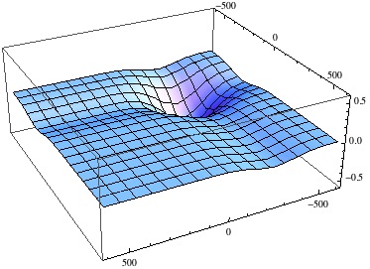
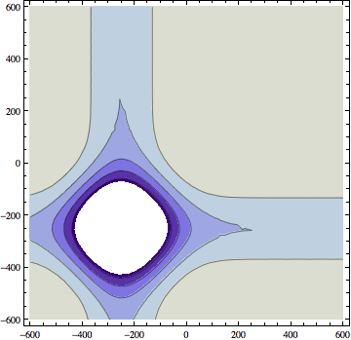
Example of a Potential Field
trails
food source

Slide 5
Trail Formation of Ants
Production term of pheromone i
Initial production
Decay parameter
Start of production
Notes:
Q_{\alpha,i}\left( \vec{r}_\alpha, t \right) = q_i \exp{\left[ -\beta_i \left( t-t_i^\alpha \right) \right]}, \quad \text{for } i \in \left\{ 1,2 \right\}
\vec{f}_{\text{tr}}^\alpha = \nabla V_{\text{tr}}^i\left( \vec{r}, \vec{v}, t \right)
\vec{e}_\alpha \left( \vec{r},\vec{v},t \right) = \frac
{\vec{f}_{\text{tr}}^\alpha\left( \vec{r},\vec{v},t \right) + \vec{e}_\alpha^* \left( t-\Delta t \right) }
{ \left\| \vec{f}_{\text{tr}}^\alpha\left( \vec{r},\vec{v},t \right) + \vec{e}_\alpha^* \left( t-\Delta t \right) \right\| }

Slide 6
Driving Force and Desired Direction
Notes:
Q_{\alpha,i}\left( \vec{r}_\alpha, t \right) = q_i \exp{\left[ -\beta_i \left( t-t_i^\alpha \right) \right]}, \quad \text{for } i \in \left\{ 1,2 \right\}
\vec{f}_{\text{tr}}^\alpha = \nabla V_{\text{tr}}^i\left( \vec{r}, \vec{v}, t \right)
\vec{e}_\alpha \left( \vec{r},\vec{v},t \right) = \frac
{\vec{f}_{\text{tr}}^\alpha\left( \vec{r},\vec{v},t \right) + \vec{e}_\alpha^* \left( t-\Delta t \right) }
{ \left\| \vec{f}_{\text{tr}}^\alpha\left( \vec{r},\vec{v},t \right) + \vec{e}_\alpha^* \left( t-\Delta t \right) \right\| }

Slide 7
Experiment vs Model
D. Helbing et al., Active Walker Model for the Formation of Human and Animal Trail Systems. Physical Review, 1997;56:2527-2539

Slide 8
Trail Formation of Humans
Strength of markings by footprints
Intensity of clearing vegetation
Clarity of an existing trail
Maximum reachable clarity of trail
Notes:
Q_\alpha \left( \vec{r},t \right)= I \left( \vec{r} \right) \left[ 1- \frac{G\left( \vec{r},t \right)}{G_{\text{max}}\left( \vec{r},t \right) } \right]

Slide 9
Desired Direction
Destination potential:
Trail potential:
Notes:
\vec{e}_\alpha \left( \vec{r}, \vec{v}, t \right) = \frac
{\nabla \left[ U_\alpha \left( \vec{r} \right) + V_{\text{tr}}\left( \vec{r},t \right) \right] }
{\left\| U_\alpha \left(\vec{r} \right) + V_{\text{tr}}\left( \vec{r},t \right) \right\|}
U_\alpha \left( \vec{r} \right) = - \left\| \vec{d}_\alpha - \vec{r} \right\|
V_{\text{tr}} \left( \vec{r}_\alpha,t \right) = \int{ e^{- \left\| \vec{r} - \vec{r}_\alpha \right\| / \sigma \left( \vec{r}_\alpha \right) } G\left( \vec{r},t \right) d^2r}

Slide 10
Results of the Model
D. Helbing et al., Active Walker Model for the Formation of Human and Animal Trail Systems. Physical Review, 1997;56:2527-2539

Slide 11
Questions?

