Slide 1
Norm Violation and the Second-Order Free Rider Dilemma
Strategic Self-Interest versus Altruistic Punishment
Andreas Diekmann
(experiments with Wojtek Przepiorka)
(eBay-Study with B. Jann, W. Przepioka, S. Wehrli)
ETH Zurich; Nuffield College, Oxford; University of Utrecht
Notes:
1

Slide 2
The Ebay Market and the Second Order Free Rider Dilemma
Why is a Solution to the Second-Order Free Rider Dilemma Important to Keep Society Together?
The Linear Public Good Game and Altruistic Punishment
The Second-Order Free Rider Problem as a Volunteer‘s Dilemma: Other Regarding Preferences are not Necessary to Promote Cooperation. Selfish Actors Alone are Capable to Produce Cooperation
Missing-Hero Dilemma: Here are Other Regarding Preferences Required for Cooperation.
Experiment I: Symmetric and Asymmetric: Volunteer‘s Dilemma
Experiment II: Missing-Hero Dilemma
Conclusion

Slide 3
Second-Order Free Rider Problem
► eBay Market: Transactions between anonymous actors over long distances.
► First-order collective good: Cooperative market with actors who comply with the norm of honest transactions.
► However, both sellers and buyers have incentives to cheat. Why does the market not collaps?
Answer?

Slide 4

The Reputation System

Slide 5
Upholding Reputation as a Second-Order
Free Rider Problem
Answer: Reputation („Reputation, reputation, reputation! O, I have lost my reputation! I have lost the immortal part of myself, and what remains is bestial. My reputation, Iago, my reputation!” Cassio in Othello)
►The reputation system is a second-order collective good! Actors have to give feedback (positive and negative sanctions) to upheld the reputation system, i.e. to choose cooperation.
► However, feedback giving is the Achilles heel of the whole system. Feed back giving is costly - albeit the costs are low. Selfish actors would refrain from feed back giving and the reputation system (second order) would break down leading to the collapse of the whole market.
► Feed back giving is driven by positive and negative recoprocity (“strong reciprocity”) or “other regarding preferences”. Homo Socialis is essential for the functioning of electronic markets!
►We studied the whole system empirically with econometric methods and more than 300’000 auctions from eBay (Diekmann, Jann, Przepiorka, Wehrli, 2014. American Sociological Review 79: 65-85)

Slide 6
Second-Order Free Rider Problem
Why is it so important?
1. First order collective good problem. Actors have the option to comply with a social norm (cooperation C) or to violate the norm (defection (D) = free riding). Examples: Paying taxes, do not litter, do not dodge the fare, reduce CO2-emissions.
What happens? Cooperation will decay or not emerge. Imagine the Zurich tram system without any control of tickets! Or payment of tax without any sanctions for dodging taxes. Clearly, cooperative systems will eventually break down.
2. Second-order collective good problem. Assume there is no central authority but peer punishment. Other actors (strangers, neighbours, friends etc.) are able to punish norm violations and punishment incurs some cost.
►Is this a solution – will cooperation emerge and being stable?

Slide 7
Second-Order Free Rider Problem
►The second-order free-rider problem is a core problem of social cooperation. It is central for the question: What keeps society together?
►Many suggestions to solve this problem. A well known solution is Fehr and Gächter‘s idea of „altruistic punishment“ corroborated by an experiment with the Public Good Game (PGG).

Slide 8
Linear Public Good Game (PGG)
PGG
4 Players, simultaneous decisions.
20 points endowment per player per round.
Player can invest any part of his endowment in the public fund and keeps the remaining points privately.
After each round a player receives 0.4 (40%) of the money in the fund.
Example: Each player A, B and C adds 20 points to the fund. D is a free rider and keeps his 20 points privately.
Payoff to A, B, C: P(Coop) = 0.4 x 60 = 24
Payoff to D: P(Defect) = 24 + 20 = 44
Full cooperation P(Coop) = 0,4 x 80 = 32; in case all players defect:
P(Defect) = 20.
Dominant strategy?
Nash-equilibrium strategy?
(Note: PGG was introduced by sociologists Gerald Marwell and Ruth Ames in 1979. Today the game plays the role of the drosophyla in behavioral economics)

Slide 9
Linear Public Good Game with Punishment Option
Phase 1: PGG
4 Players, simultaneous decisions.
20 points endowment per player per round.
Player can invest any part of his endowment in the public fund and keeps the remaining points privately.
After each round a player receives 0.4 (40%) of the money in the fund.
Example: Each player A, B and C adds 20 points to the fund. D is a free rider and keeps his 20 points privately.
Payoff to A, B, C: P(Coop) = 0.4 x 60 = 24
Payoff to D: P(Defect) = 24 + 20 = 44
Full cooperation P(Coop) = 0,4 x 80 = 32; in case all players defect:
P(Defect) = 20.
Phase 2: Punishment Option (Fehr and Gächter)
A player has the option to punish any other player by 0 to 10 points.
A punishment point costs the punisher 1 point and the punished player 3 points. (For example, A punishes B with 3 points and D with 2 points. Then, A has a loss of 5, B has a loss of 9, and D has a loss of 6 points.
►Will cooperation emerge? Dominant strategy? Nash equilibrium strategy?

Slide 10
“Altruistic Punishment in Humans”
Fehr, E. and Gächter, S., 2002. Altruistic Punishment in Humans. Nature 415: 137-140
Notes:
10

Slide 11
Why the linear PGG is not an universal
paradigm for public good problems and
the second-order free rider problem!

Slide 12
Three key problems with the two-stage linear PGG plus punishment model
Problem 1: Punishment costs may exceed gains of cooperation (at least in the short run) and there is waste of resources (Boyd, Gintis, Bowles 2010).
Problem 2: Restrictive assumptions to explain the evolution of altruistic (or ‚punitive‘) preferences (Raihani & Bshary 2011).
Problem 3: The linear PGG is not always a proper model of a sanctioning problem. There are many situations in real life where N actors observe a norm violation and one actor is sufficient to punish a transgressor. Volunteer‘s Dilemma is a model for this type of a sanctioning dilemma (Diekmann 1985,1993, Raihani & Bshary 2011)

Slide 13
Nonlinear PGG. Volunteer‘s Dilemma as an alternative model for peer punishment and the second-order free rider dilemma
Are selfish strategic motives sufficient to sanction norm violations?
This would be a more parsimonious explanation.
3. Does asymmetry (heterogeneity) of
actor‘s interest in the collective good or
asymmetry of sanctioning costs promotes
cooperation?
4. Selfish motives versus altruistic punishment.

Slide 14
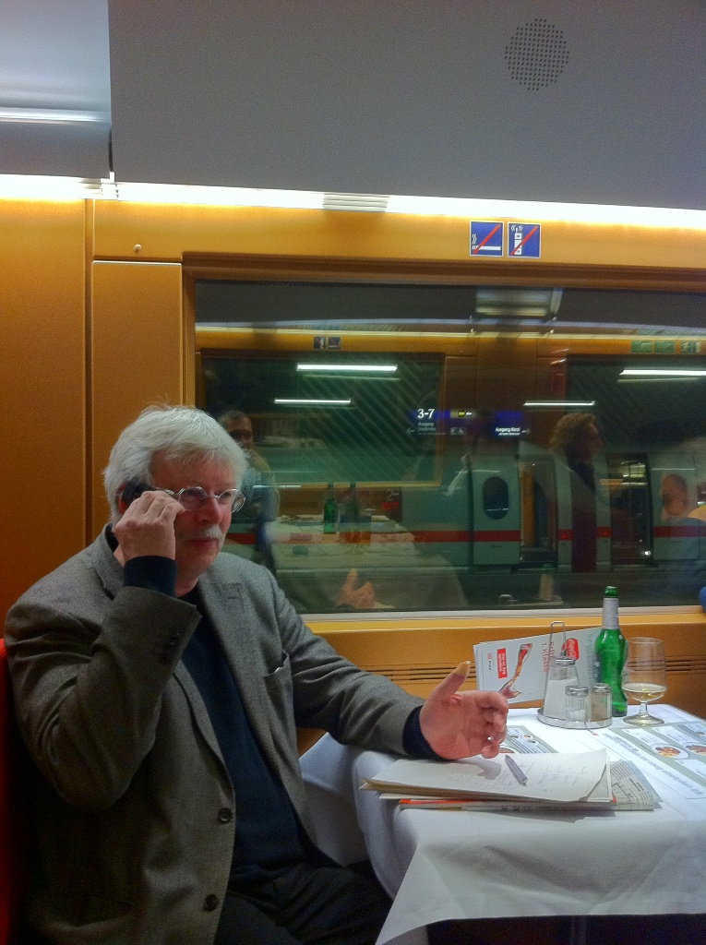
Sanctioning Dilemma
N bystander. Who is ready
to punish the norm violator?
(One bystander is sufficient
for punishment.)

Slide 15
Sanctioning Dilemma
N bystander. Who is ready
to punish the norm violator?
(One bystander is sufficient
for punishment.)

Slide 16

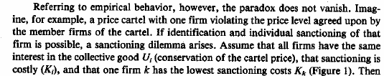
Sanctioning as a volunteer‘s dilemma
Diekmann, A., 1993. Cooperation in an asymmetric
volunteer‘s dilemma, Int. J. of Game Theory 22

Slide 17
„The evolution of punishment to stabilize cooperation
in n-player games has been treated as a second-order
social dilemma, where contributions to punishment of
free-riders are altruistic. Hence it may only evolve
under highly restricted conditions.“
Evolution 2011

Slide 18
Volunteer‘s Dilemma (VOD)
Symmetric VOD
Three players have the option to either choose 100 Fr. or 20 Fr. All wishes will be fullfilled provided at least one player decides for 20 Fr. Otherwise all players get nothing!
2. Asymmetric VOD
Here one player („the strong player“) has the option between 100 Fr. versus 50 Fr. All other „weak“ players‘ option is 100 Fr. versus 20 Fr.

Slide 19
Volunteer’s Dilemma
The Volunteer’s Dilemma is a N-player binary choice game (for N ≥ 2) with a step-level production function. A player can produce a collective good at cost K > 0. When the good is produced, each player obtains the benefit U > K > 0. If no player volunteers, the good is not produced and all players receive a payoff 0.
Example: “Bystander intervention in emergencies” (Darley & Latane 1968)
► Actor’s choice is “defection”: Actor receives U if at least one other
player is cooperative and 0 otherwise. (Example U = 100)
► Actor’s choice is “cooperation”: Actor receives U – K with certainty.
(Example: U = 100, K = 80, U – K = 20)
 | 0 | 1 | 2 | … | N - 1 | other C-Players
C | U - K | U - K | U - K | … | U - K
D | 0 | U | U | … | U | U > K > 0
No dominant strategy, but N asymmetric pure equilibria in which one player volunteers while all other defect. Cf. Diekmann (1985).
Moreover, another equilibrium in mixed strategies with symmetric payoffs.

Slide 20
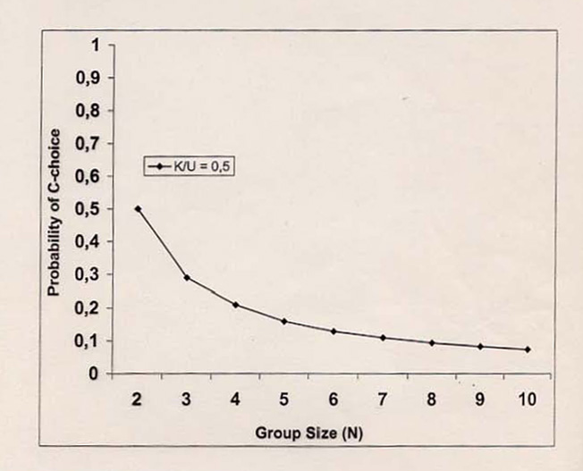
Nash-Equilibrium (Symmetric VOD)
 | 0 | 1 | 2 | … | N - 1 | other C-Players
C | U - K | U - K | U - K | … | U - K
D | 0 | U | U | … | U | U > K > 0
►Pure strategy equilibria:
(C, D, D, …, D)
(D, C, D, …, D)
…
(D, D, D, …, C)
►Mixed strategy equilibrium with p = probability of cooperation:
p = 1 - ^{N-1}√ K/U
►∂p/∂K < 0
∂p/∂U > 0
∂p/∂N < 0
Notes:
20

Slide 21
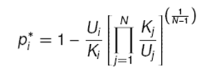
Asymmetric Volunteer’s Dilemma
Heterogeneity of costs and gains: U_{i}, K_{i} for i = 1, …, N; U_{i} > (U_{i} – K_{i}) > 0
Special case: A “strong” cooperative player receives U_{s} – K_{s} , N-1 symmetric “weak” players’ get U – K whereby:
U_{s} – K_{s} > U_{w} – K_{w} > 0
Strategy profile of an “asymmetric”, efficient (Pareto optimal) Nash equilibrium (follows from Harsanyi-Selten rationality theory, cf. Diekmann 1993):
► s = (C_{s}, D, D, D, D, …,D)
I.e. the “strong player” is the volunteer (the player with the lowest cost and/or the highest gain). All other players defect.
► In the asymmetric dilemma: Exploitation of the strong player by the weak actors.
►Paradox of mixed Nash equilibrium: The strongest player is the least likely to take action!
Cooperation:

Slide 22
The sanctioning dilemma is only one application of the volunteer‘s dilemma
There are many other examples of a volunteer‘s dilemma in:
► Sociology, social psychology (bystander effect and diffusion of responsibility)
Economics (e.g. innovations and patent rights) etc.
Computer sciences (decentralized computer networks)
Traffic communication systems etc.
► Biologists found numerous situations corresponding to a volunteer‘s dilemma in
recent years (mammals defending a territory, alarm calls, many examples of microorganisms, Archetti 2009a,b, 2010 etc.)
► Interesting example: „Invertase in yeast are public goods (= U) because they are
diffused outside the cell; their production is costly (= K), but their lack, if nobody
produces them, can be lethal“ (= 0), Archetti 2009, Gore et al. 2009)
► „Some other cases have been classified as snowdrift game (SG), although in fact
they are also volunteer‘s dilemmas because they do not involve pairwise interactions“ (Archetti 2009)

Slide 23
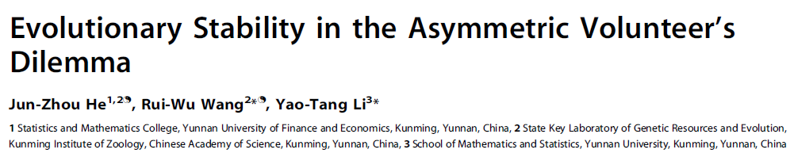
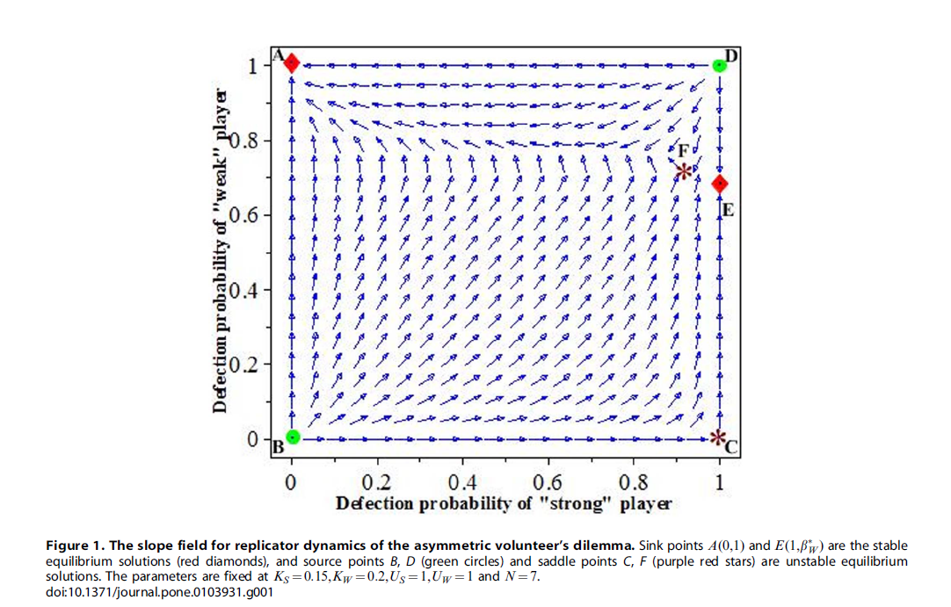
PLoS one August 2014
► s = (C_{s}, D, D, D, D, …,D)
► strong player cooperates,
weak players free ride
is stable ESS

Slide 24
Experiment 1 with the symmetric and asymmetric volunteer‘s dilemma as an alternative model for the sanctioning problem:
Hypotheses (derived from standard game theory):
1. Actors execute self-interested, strategic punishment.
The assumption of „punitive“ preferences (altruistic punishment) is not necessary!
2. Higher strategic punishment rates in the asymmetric situation compared to the symmetric dilemma.
3. Efficiency. The rate of „efficient“ punishment (no waste of punishment costs), i.e. exactly one actor punishes is higher in the asymmetric compared to the symmetric situation.
4. Deterrence. With a punishment option the rate of norm violations will be larger in the symmetric than in the asymmetric situation.

Slide 25
The strategic situation
Player X (the potential wrongdoer) decides either
to violate or to stick to a norm.
The violation of the norm hurts players A, B, C
(a negative externality).
Players A, B, C have the possibility to punish
norm violations. A, B, C are in a VOD situation.
One player is sufficient to sanction X on cost K
thereby restoring the norm (production of the collective
good U > K). In more detail:

Slide 26
A single actor is sufficient to sanction a norm violation.
Sanctioning is costly (K) and restores the social norm. Both, sanctioning and free riding victims of a norm violation profit (U) with U > K.
Groups of four consisting of player X and three other players A, B, C. Players have an endowment of 140 each.
X has the option to steal 70 from each of the other players A,B,C. If he steals he will get 350 = 140 + 210 while A,B,C have 70 each. Distribution: (350, 70, 70, 70)
However, A, B, C have a veto right. A veto costs 30 and X is obliged to pay the stolen money back. A veto by B and C (and zero punishment for X) results in the following distribution: (140, 140, 110, 110).
Punishment costs vary in treatments: 1. No punishment, 2. low punishment (40), 3. high punishment (120).
Example: Endowment 140. X steals. A vetoes, low punishment of 40, K=30. Resulting distribution: X = 100, A = 110, B = 140, C = 140

Slide 27
Two further conditions: Symmetric and asymmetric game
1. Symmetric game
N = 3 „victims“, collective good U = 70, veto costs K = 30
Individual cooperation:
Mixed Nash-equilibrium: P(cooperation) = 1- ^{(N-1)}√ K/U = 1 - √ 30/70 = 0.345
Collective good production:
Probability that at least one player vetoes: 1 – (1-0.345)³ = 0.72
Efficient production of collective good:
Probability that exactly one player vetoes: 3 ∙ 0.345 ∙ 0.655² = 0.444
2. Asymmetric game
N = 3 victims, veto costs of „weak“ players 40, veto cost of „strong“ player 30.
Nash-equilibrium prediction:
P(cooperation strong player) = 1
P(cooperation weak player) = 0.

Slide 28

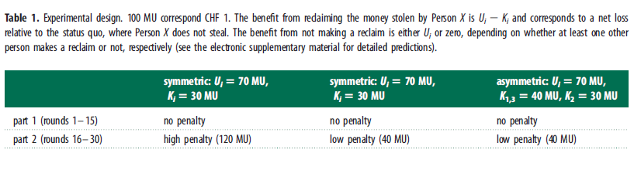
Online march 27, 2013
Experiment in our computer lab DeSciL

Slide 29
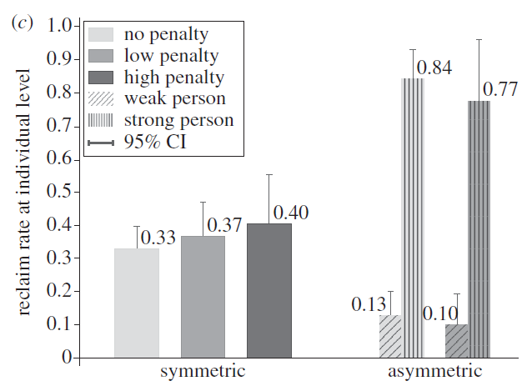
Individual level punishment of norm violation by victims (second-order cooperation)
Results are very well in
accordance with game
theory predictions
►Self interested punishment
►Higher rates in asymmetric
situation
►Punishment is more efficient
in asymmetric game (strong
player cooperates)
Prediction (mixed Nash equilibrium Strong: p = 1, weak: p = 0
strategy): p = 0.345

Slide 30
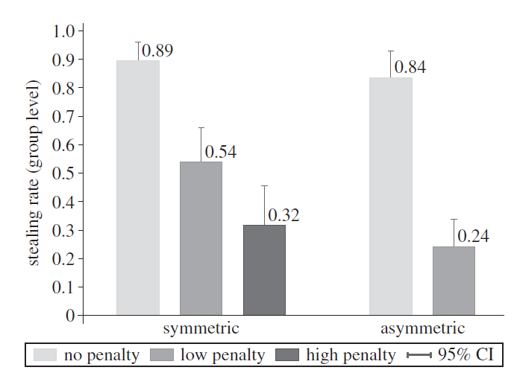
Stealing Rate of Actor X
Note: In the symmetric condition stealing drops by 58 percent points
If there is a penalty of 120. In the asymmetric condition the rate drops
By 59 percent points with a penalty of 40. the deterrence effect of asymmetry
Is three times the size of the penalty.

Slide 31
Stealing Rate of Actor X
Penal120
40
Note: In the symmetric condition stealing drops by 58 percent points
If there is a penalty of 120. In the asymmetric condition the rate drops
By 59 percent points with a penalty of 40. The deterrence effect of asymmetry
Is three times the size of the penalty.

Slide 32
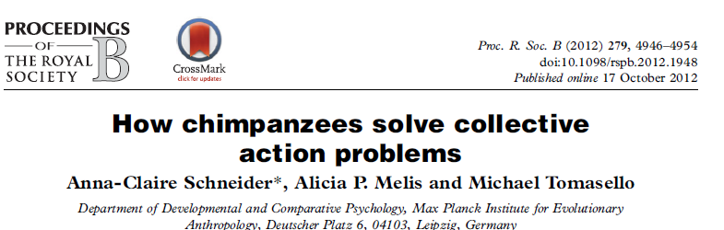
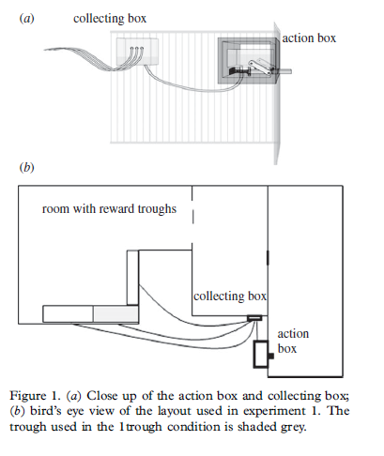
Chimpanzees solve an asymmetric
collective action problem
Groups of three. One actor (operating the action box in room 3) is sufficient to produce the collective good U (orange juice In room 1). The cooperative player has costs K because he has to move from (3) to (1) and might get a
smaller amount of juice than free riders.
(1)
(2)
(3)

Slide 33
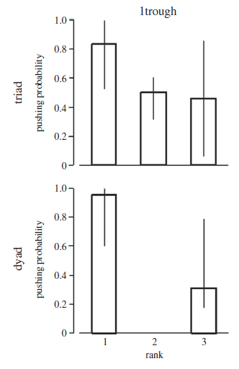
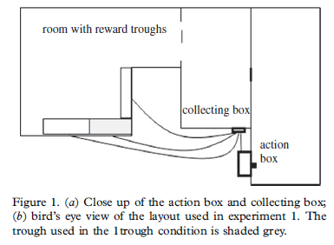
Schneider, Melis, Tomaselli (2012)
Foto: Süddeutsche Zeitung, 5.4.13
High ranked
(strong) actors
cooperate while
weak actors
free ride (high
rank = 1, low
rank = 3.)
High rank

Slide 34
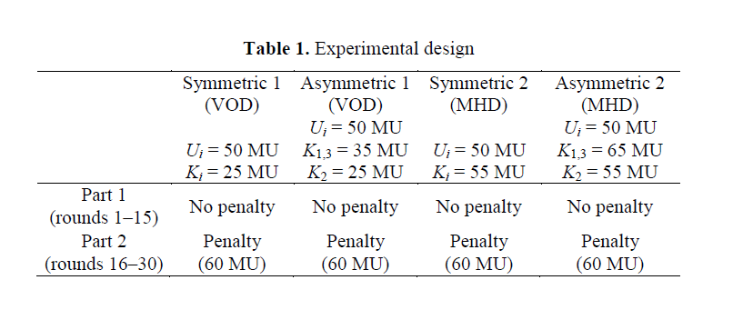
Norm violation: X steals 150
► U_{i} = 50
Number of subjects 48 48 48 48

Slide 35
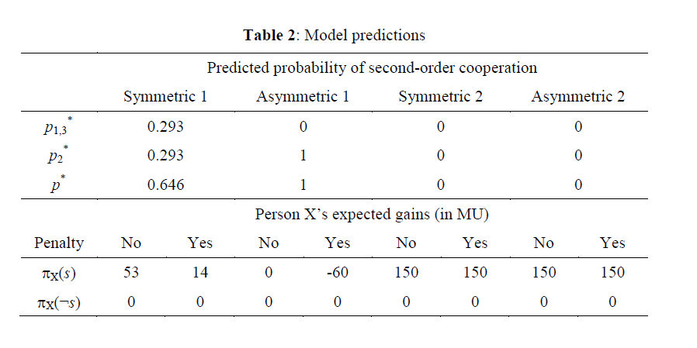

Slide 36
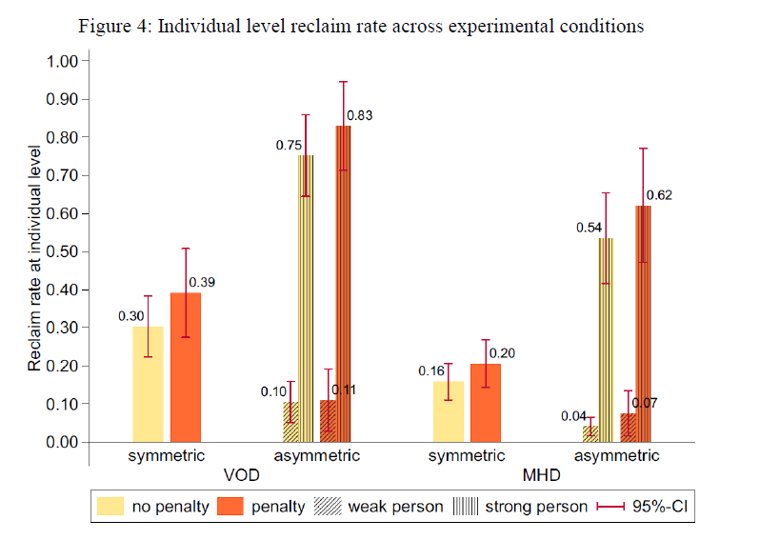
►Punishment due to selfish strategic reasons as well as altruistic punishment

Slide 37
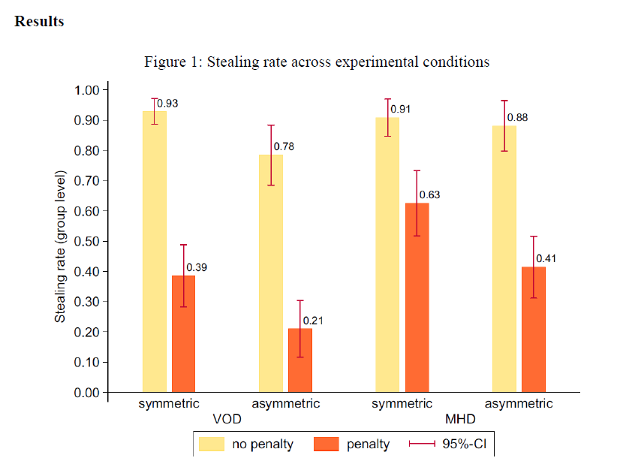
Norm violation lowest in the asymetric VOD

Slide 38
Peer-Punishment
Many collective good problems are not adequately modeled by the linear public good game.
Often, one person is sufficient to punish norm violations.
The punishing actor profits, albeit not as much as free riders (K < U).
Under these conditions, the sanctioning dilemma („second-order free rider dilemma“) is a volunteer‘s dilemma.
Then we have „strategic“ punishment instead of „altruistic“ punishment and the assumption of ‚punitive preference‘ is no longer necessary.
However, there is „diffusion of responsibility“ in a symmetric game. Asymmetry counteracts this effect and promotes cooperation – As a deterrent a certain stick helps more than a diffuse stick.
Strong actors cooperate in the asymmetric dilemma – exploitation of the strong by the weak!

Slide 39
Experiment II
Peer punishment due to strategic self-interest.
Asymmetry promotes efficient cooperation.
Results replicate experiment I and the predictions are very much in accordance with game theory models.
However, in contrast to predictions of game theory and in accordance with „negative reciprocity“ there is a moderate degree of altruistic punishment (20 %)
and a very high degree of altruistic punishment in the asymmetric MHD.

Slide 40
Conclusion
►The second-order free rider problem as a volunteer‘s dilemma is often more realistic.
► So, other regarding preferences are not necessary to promote cooperation!
► However, a certain proportion clearly has other regarding preferences which additionaly support the emergence and stability of cooperation.

Slide 41

The End

Slide 43
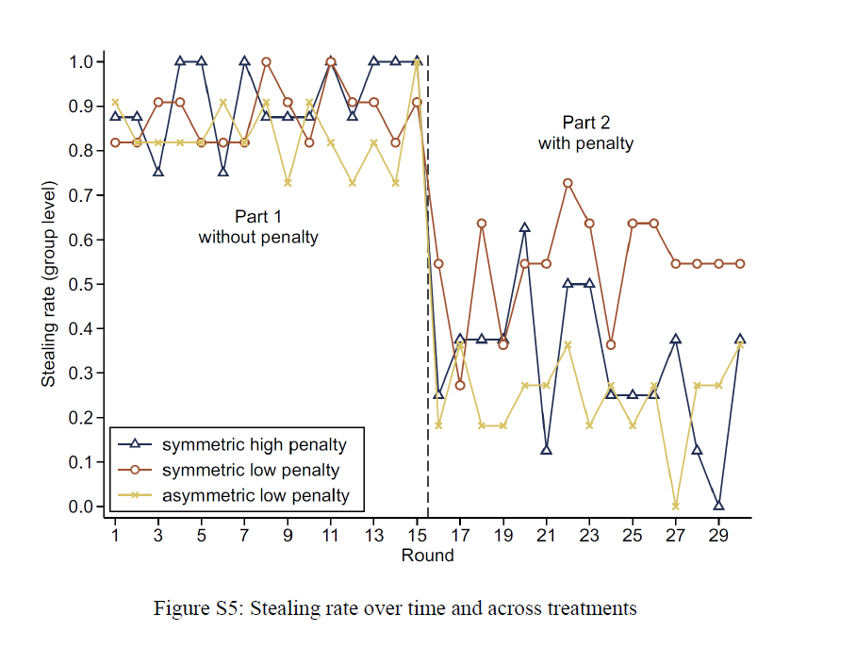
Deterrence: Offender‘s stealing rate
► Low penalty in asymmetric situation has the same effect as high penalty
in the symmetric situation

Slide 44
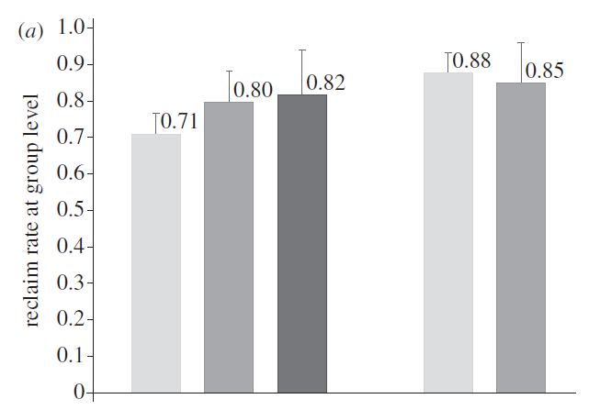
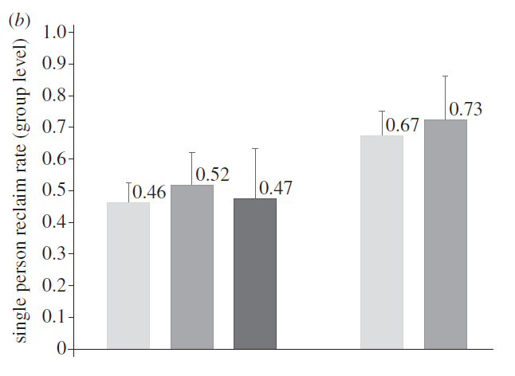
At least one victim vetoes
(punishment of cheater)
Symmetric, predicted 0.72
Asymmetric, predicted 1
symmetric asymmetric
Exactly one victim vetoes
(efficient punishment)
Symmetric, predicted 0.44
Asymmetric, predicted 1

Slide 45
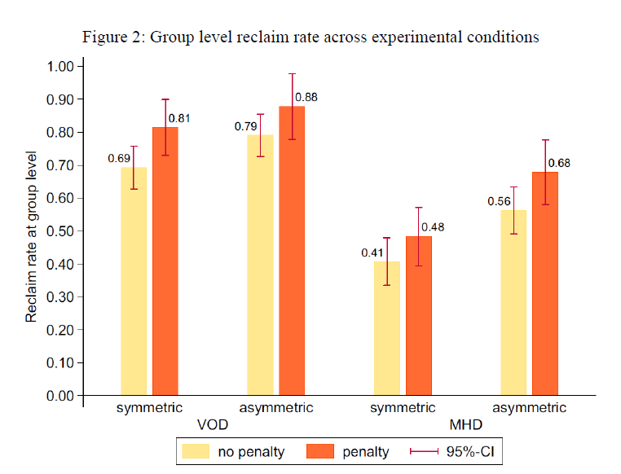

Slide 46
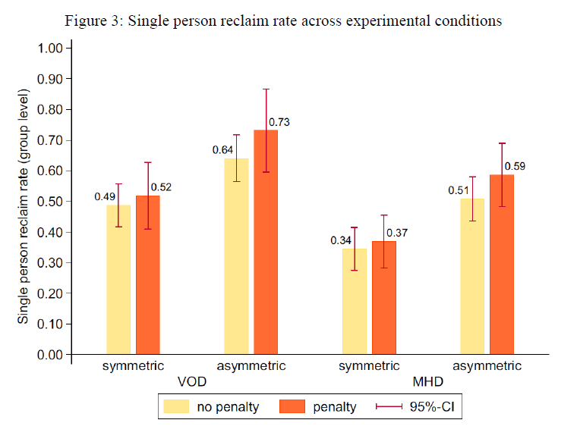

Slide 47
Predicted and observed behavior
(no penalty condition)
Observed
At least one victim vetoes
(punishment of cheater)
Symmetric, predicted 0.72
Asymmetric, predicted 1
0.71
0.88
Exactly one victim vetoes
(efficient punishment)
Symmetric, predicted 0.44
Asymmetric, predicted 1
0.46
0.67
Prediction (Nash equilibrium
strategy):
Symmetric: 0.345
Asymmetric strong 1, weak 0
0.33
0.84; 0.13

Slide 48
Robert Boyd, Herbert Gintis, Samuel Bowles, 2010. Coordinated Punishment of Defectors Sustains Cooperation and Can Proliferate When Rare, Science 328: 617
„Moreover, in human behavioral experiments in which punishment is uncoordinated, the sum of costs to punishers and their targets often exceeds the benefits of the increased cooperation that results from the punishment of free-riders. As a result, cooperation sustained by punishment may actually reduce the average payoffs of group members in comparison with groups in which punishment of free-riders is not an option.“
Problem: Waste of resources by punishment. Difficult to
explain the evolution of cooperation because individuals
who punish have smaller survival chances.

Slide 49
Asymmetry and Cooperation
Whelan (1997) provides an example from ancient politics which is analyzed in terms of collective good theory:
As the Greek polis’ had been under threat by the Persian emperor Darius in the fifth century B.C. Athens was the volunteer to resist the Persian attack while other Greek states such as Sparta defected.
The collective good of Greek independence was preserved by the victory of Athens at Marathon.
In this historical example, the strategic interactions of states resemble an asymmetric volunteer’s dilemma.
About sixty polis had an interest not being colonized by the Persians.
Most of them defected while Athens, the most powerful state, was almost alone to act in the common interest.

